Slide 1
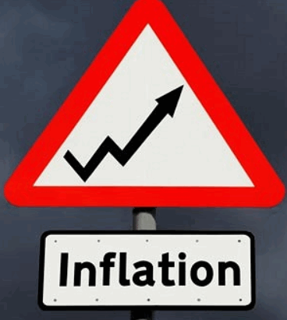
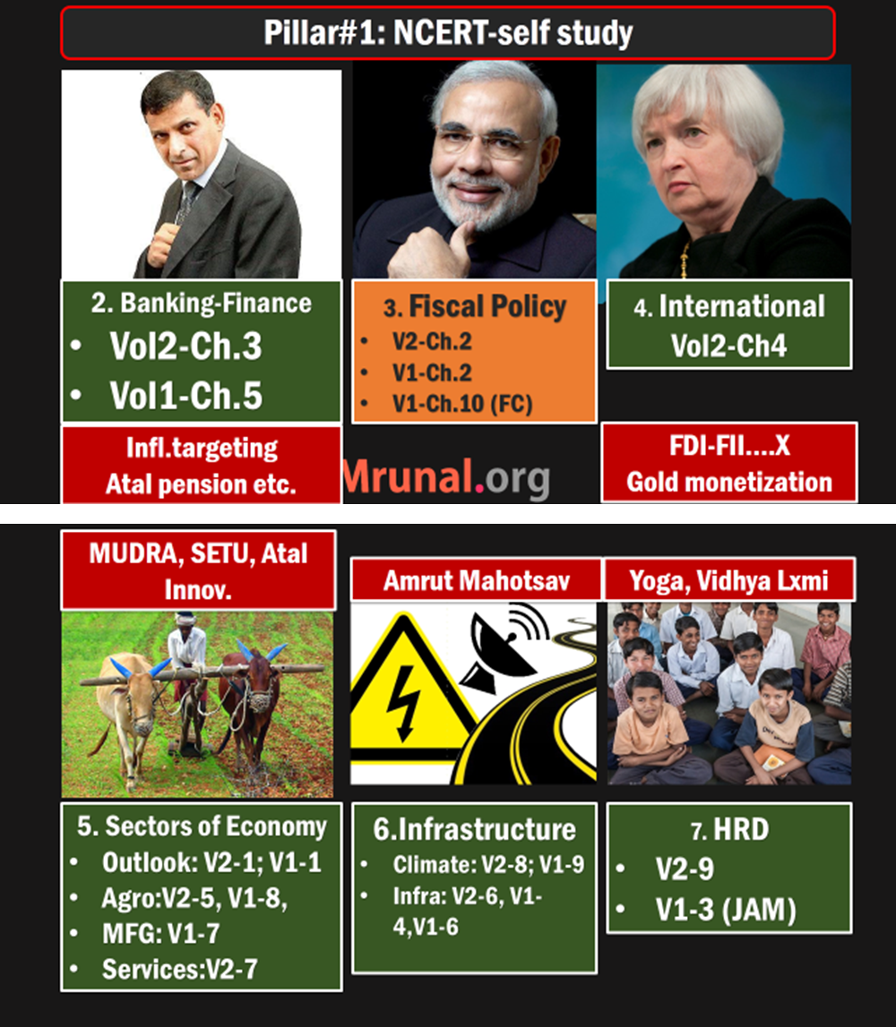
Self study: ch7- inflation and Biz cycle Ramesh Singh. Only definitions & impact. line by line
Lecture: selected Theory and current (survey)

Slide 2
Inflation related Topics
Index theory
WPI, CPI, IIP
Survey analysis
Misc. Indexes

Slide 3


2015
Rs.15
2012
Rs.10
$Inflation=\frac{Price in Current Year}{Price in Base year}$=15/10=50%

Slide 4



??
??
2015
Rs.15
2012
Rs.10
$$Inflation=\frac{Price in Current Year}{Price in Base year}$$

Slide 5
2012
2015
10
15
50
60
1000
1200

Slide 6
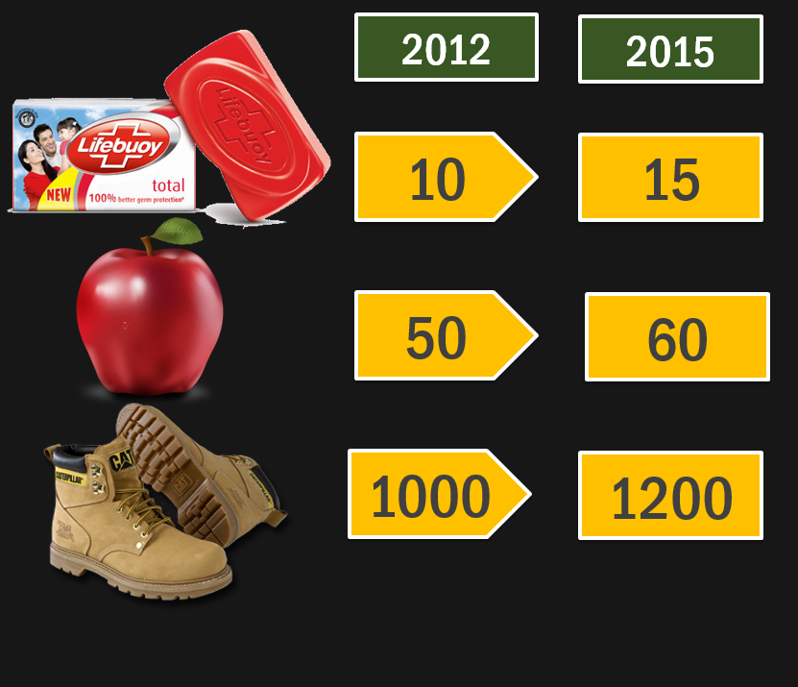

But are all commodities
used in same quantity
and frequency every day?
1060
1275
$$Inflation=\frac{Price in Current Year (1275)}{Price in Base year (1060)}$$
20.3%

Slide 7
weight
2012
2015
Price ratio: 2015/2012
Ratio x wt.
30
10
15
1.5
45
60
50
60
1.2
72
10
1000
1200
1.2
12
Total 100
Total 129
Inflation: 129/100 = 29%

Slide 8
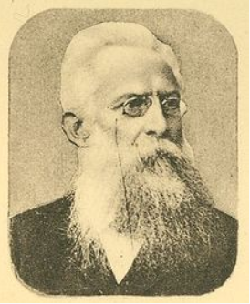

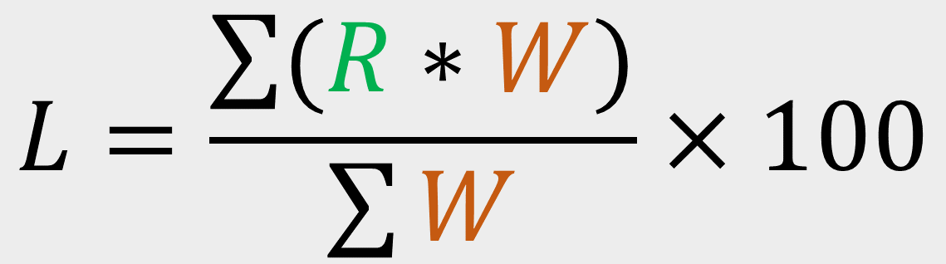

Inflation: Laspeyres formula (German)
$$L=\frac{\sum{(R∗W)}}{\sum{W}}×100$$
$$Where \text{"}\text{R}\text{"}=\frac{Price in current}{Price in Base year}$$
$$Where \text{W}\text{=}\text{weight} \text{assigned} \text{to}$$
$$\text{each} \text{commodity}$$

Slide 9
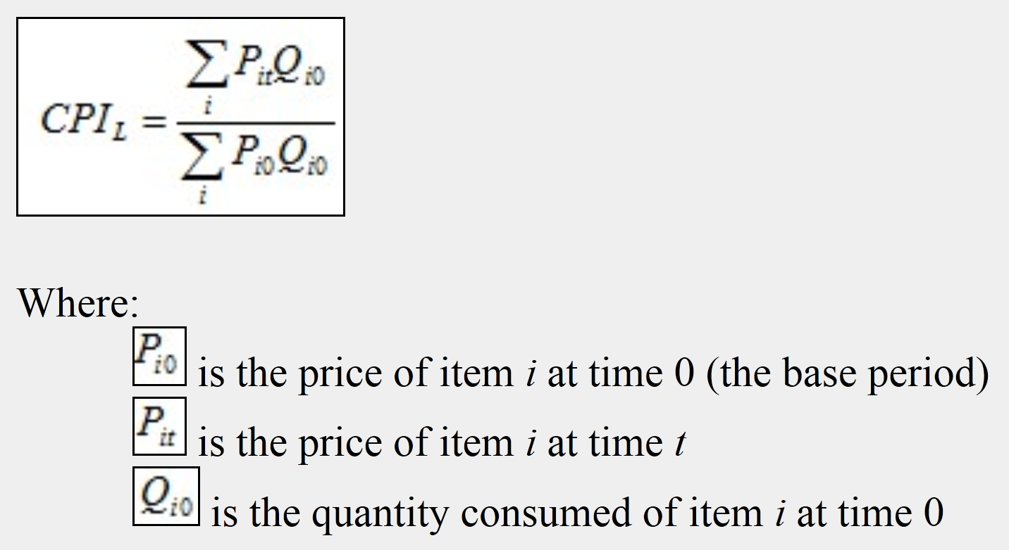
Inflation: Laspeyres formula (alternate)
Notes:
Laspeyre was a German economist .
His formula used in calculation of WPI, CPI, IIP, service price indices.
It is a Weighted arithmetic mean.

Slide 10


Laspeyres
Paasche index
Geometric mean
$$CPIF=\sqrt{CPIL×CPIP}$$
Fischer index: removes item substitution bias when prices rise
Notes:
The Laspeyres price index ignores any change in the quantities bought.
I
t will
tend to exaggerate
the effect of a
price increase
. This
is because
consumers
will
usually buy
less when the price rises or buy
other
products
that have
lower price increases
instead

Slide 11
Inflation Topics
Index theory for more Ramesh Ch.7
WPI, CPI, IIP
Survey analysis
Misc. Indexes

Slide 12


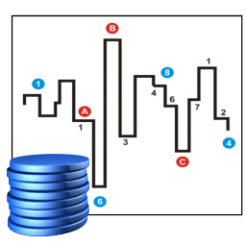


calculating inflation
Basket?
Trend analysis
Economic Survey
Who
calculates?
Base year

Slide 13
calculating inflation / production
Parameter
WPI
WHO?
Eco. Advisor, DIPP
CPI
IIP
CSO
CSO
GDP
CSO
Base
2004
2010 2012
2004
2004 2011
Laspeyres
L5/P1 .pptx

Slide 14


calculating inflation / production
Basket?
Trend analysis
Economic Survey
Who
calculates?
Base year

Slide 15
WPI 3 cat.
CPI 6 cat.
IIP 3 Cat.

Slide 16

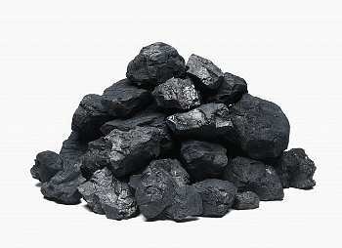

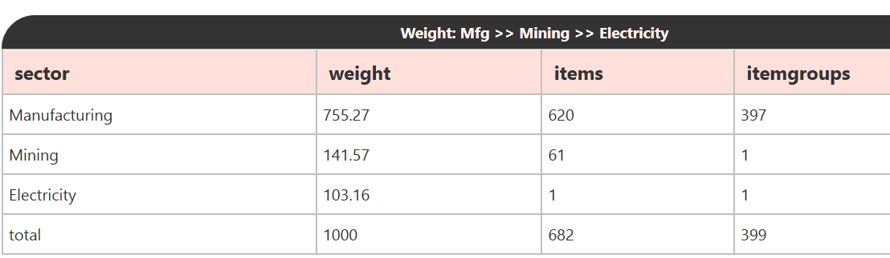
IIP Total components (682) Total WEIGHT (1000)
MFG
Mining
Electricity

Slide 17
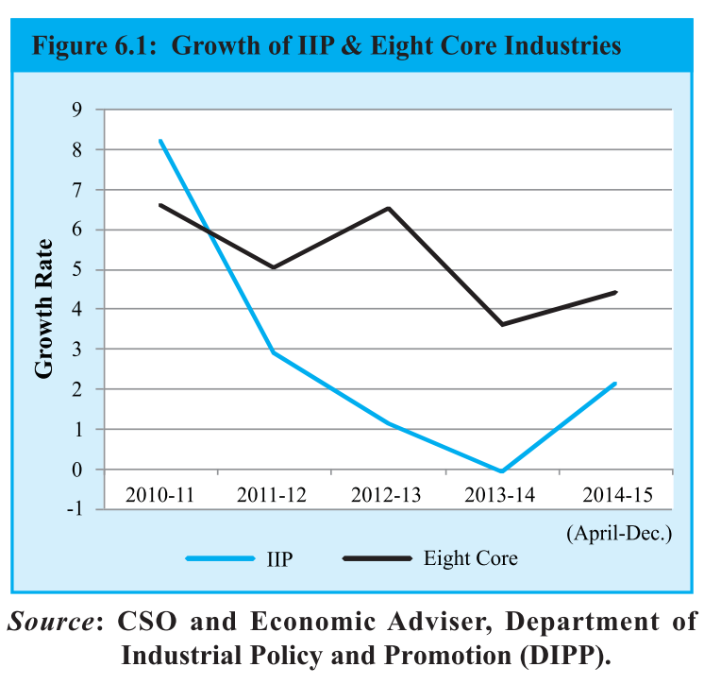
IIP: 8 core industries: ~38% of weight
Coal
Fertilizer
Electricity
Crude Oil
Natural Gas
Refinery Products
Steel
Cement

Slide 18
Survey analysis
IIP
Compared to 2011 – slowdown
8 core industries- marginal ▲
Thermal power ▲
Steel production ▼ coz cheaper imported ▲ and demand ▼
▼ Gas- oil production bcoz
No big discoveries
▼ old fields output
Fertilizer ▼ bcoz natural gas ▼

Slide 19
WPI 3 cat.
CPI 6 cat.
IIP 3 Cat.

Slide 20
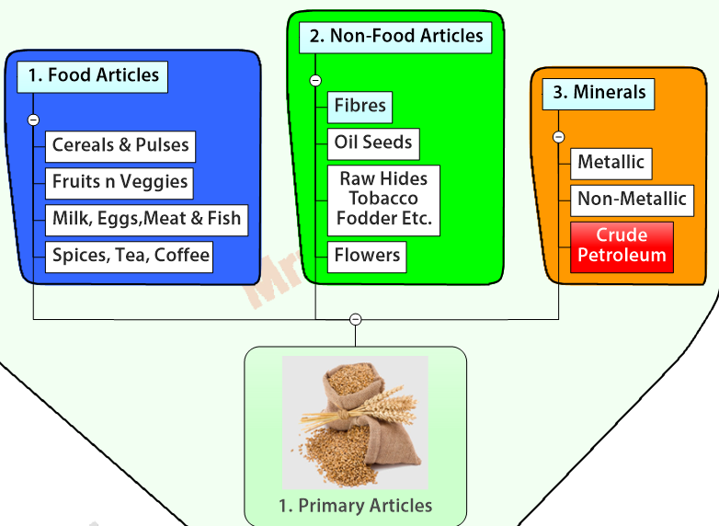
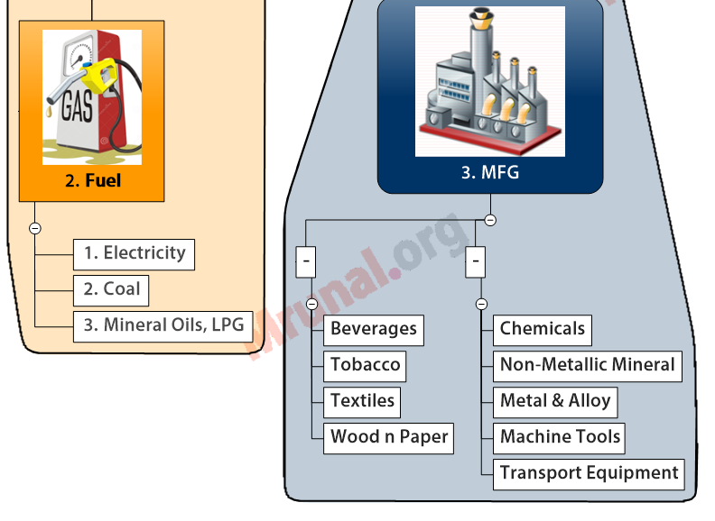
category2
category3
WPI
category1

Slide 21
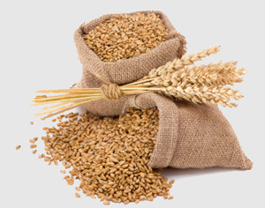

WPI: Total 676 items= headline WPI
WPI components WEIGHT
MFG. ~65%
Chem
Metal
Food
Top 3 sub-weight (DECREASING)
PRIMARY ~20%
Food
Non-food
Mineral
Fuel ~15%
Oil
Electricity
Coal

Slide 22

Core inflation WPI = headline – (food and fuel)
WPI components WEIGHT
MFG. (65%)
Chem
Metal
Food
Top 3 sub-weight (DECREASING)
PRIMARY (20%)
Food
Non-food
Mineral
Fuel (15%)
Oil
Electricity
Coal

Slide 23
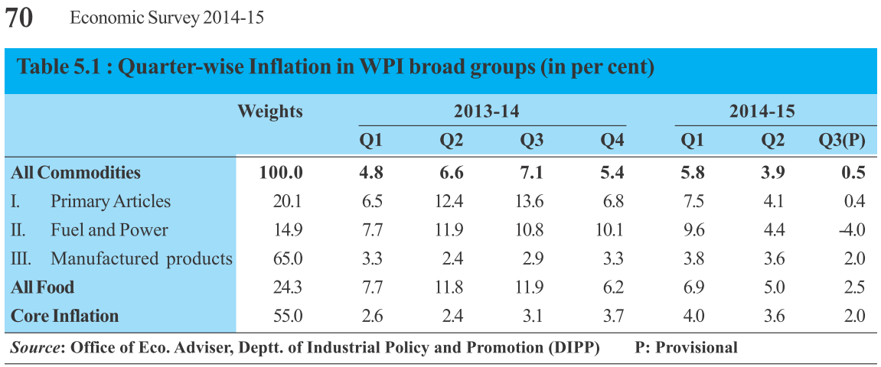

Slide 24
WPI 3 cat.
CPI 6 cat.
IIP 3 Cat.

Slide 25






CPI: 6 components Descending weight
Food, Beverage
Misc.-Health, Edu, Recreation etc.
Housing
Although N/A in rural
Fuel & LIGHT
Clothing,
Footwear
Core CPI=
Headline CPI
Minus (food & fuel)
Pan, Tobacco,
Desi intoxicants

Slide 26
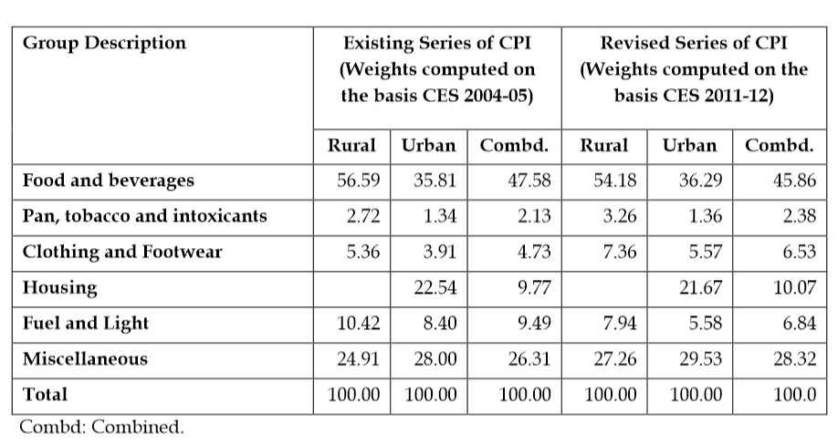
CPI weights assigned. Rural housing ignored.

Slide 27
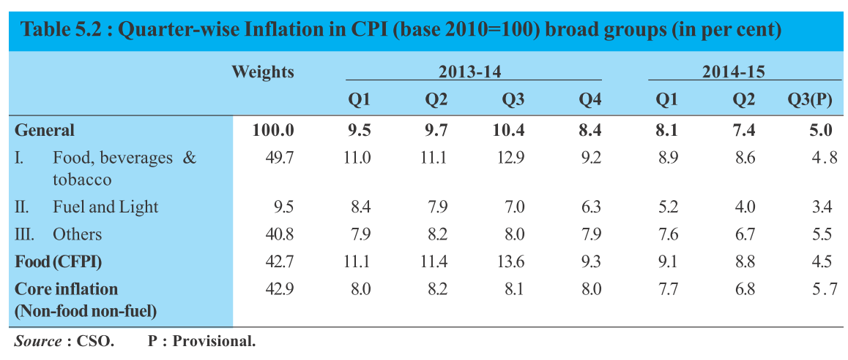

Slide 28
Reforms WEF Feb 2015
CPI
Base year 2010=> 2012
Weights assigned based on Consumer Expenditure survey 2011
Wt. Household food and fuel Expenditure (▼)
Wt. Non-food Expenditure (▲)

Slide 29
Total Basket Items ▲
CPI Reforms
CPI
Rural
Urban
Before
437
450
After
448
460

Slide 30
calculating IIP, WPI, CPI
Basket?
Economic Survey
Inflation Trend analysis
Who
calculates?
Base year

Slide 31
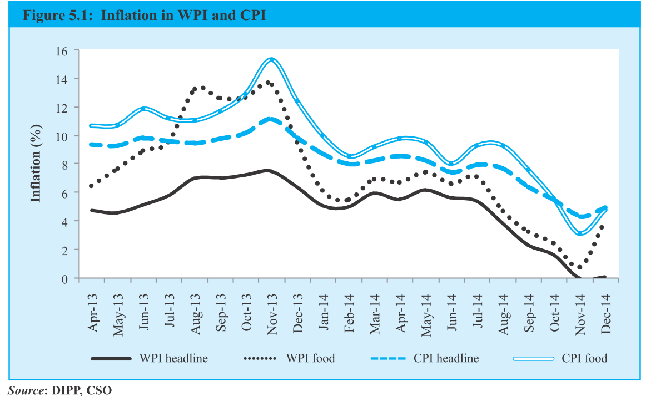

Slide 32

Declined because
Inflation
World Crude oil, edible oil, coal price ▼(Chinese slowdown)
Abundant production (FAO)
FCI open sale of grains
Union allotted 5 million tonnes of rice to BPL & APL
Potato, Onions under Essential commodities Act
Fruits, veggies outside APMC

Slide 33
Declined because
Inflation
MEP for Potato & Onions▲
RBI Tight money policy throughout 2014 (8% Repo) L1/P1.pptx
Wage growth Moderate

Slide 34
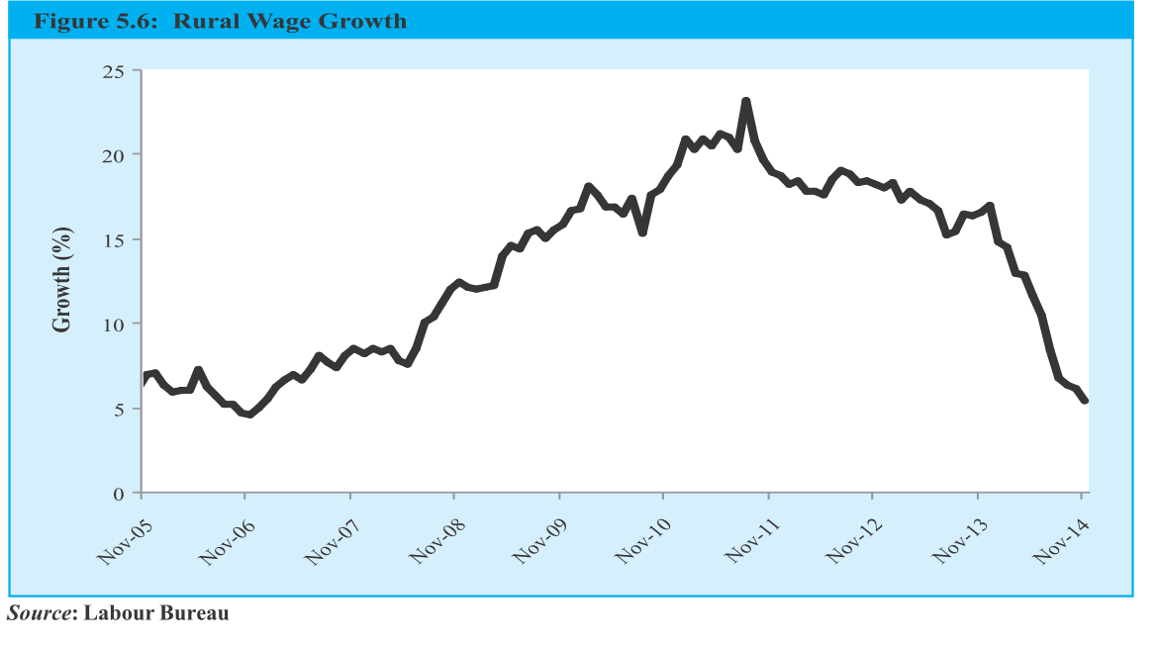

Slide 35
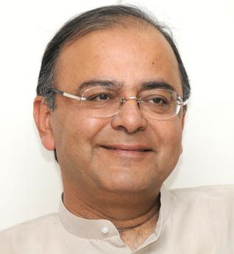
Price stabilization fund
Budget 2014
Actual March end 2015.
500 crores
Price Stabilization Fund Management Committee (PSFMC)
Chairman: Secretary of Agri. department
Interest free Loan to union and state agencies as “working capital”

Slide 36
Price stabilization fund
Budget 2014
Buy perishable agro. From farmers
Sell cheap @end user
Initial focus onion potatoes.
States to setup their own funds- contribution 50:50 (Gen.), 75:25 (NE)

Slide 37
Inflation Topics
Index theory
WPI, CPI, IIP
Survey analysis
Misc. Indexes

Slide 38

Producer’s price index
Inflation
PPI: Both goods + services (WPI only goods)
PPI: Inflation without TAXES. (WPI includes taxes & APMC levies)
Measure price change from seller’s perspective
Most OECD nations use PPI
Better sync. With System of National Account (SNA), more items, Broader coverage.

Slide 39
Producer’s price index
Inflation
Planning commission’s Abhijit Sen and Saumitra Chaudhuri Committees advocated PPI
Economic Advisor, DIPP initiated. Sought Japanese help.
Prof.BN Goldar Committee (Sep 2014)

Slide 40

Service performance index
Inflation
Service covered? WPI- no, CPI- partial, IIP- no.
Hence SPI on advice of Prof. CP Chandrasekhar Committee
by CSO

Slide 41
Index of service production (ISP) Base year 2004
Railway
Banking
Postal
Telecom
Notes:
Banking fees, commission

Slide 42

Baltic dry index
Inflation
London based Baltic exchange
Daily data
Cost to transport raw material by sea
▲ = world economy to grow
▼ = economy to slowdown

Slide 43
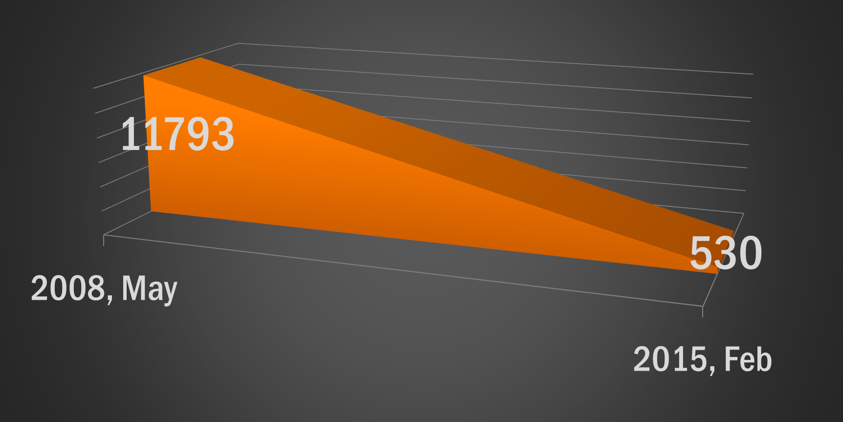
Baltic dry Index (Survey Page 116)

Slide 44
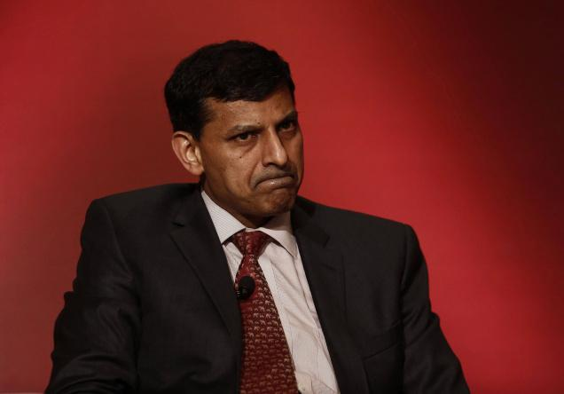
Household expectation
Inflation
Inflation expectation survey for households
RBI Since 2005
Covering 5k houses in 16 cities
3 months and 1 year ahead.
Dec 2014 data: households expected moderate inflation

Slide 45
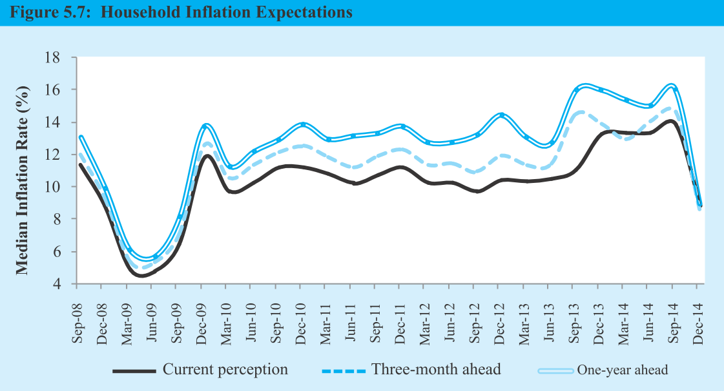

Slide 46
Misc. indexes
inflation
PPI
production
OBICUS
SPI
Baltic
SBI
ASI
Household

Slide 47
OBICUS
index
Order Books, Inventories and Capacity Utilization Survey
RBI To assess consumption & investment demand
~2500 mfg companies
Quarterly released
Survey says it (▲)

Slide 48
ASI
index
Annual survey of industries by CSO
Registered units in Factories act 1948 (10 workers- with power; 20 workers without power)
Electricity companies yes.
Movie companies, personal service etc. surveyed but DATA not tabulated.

Slide 49
ASI
index
Defense, oil, hotel café, computer, technical training inst. And other services excluded
~2.17 lakh units covered in 2012’s survey
Top 5 industrialized states: Maharashtra, Guj, TN, Karnataka, UP

Slide 50

Private entities
index
HSBC’s purchasing manager index – economic activity.
SBI composite index (launched Dec 2014)
Monthly and yearly index
0-100 scale
>50 = Economic growth
<50 = Economic contraction

Slide 51
5 Parameters covered
SBI index
Loan portfolio
Consumer Expenditure
Mining
Inflation & interest rates
Exchange rates

Slide 52
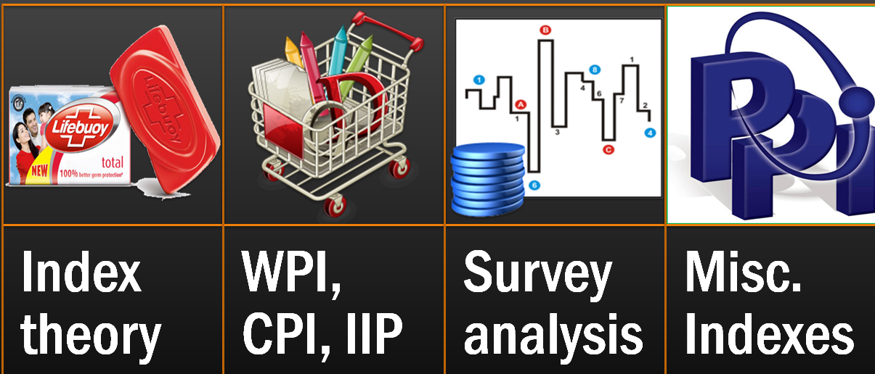
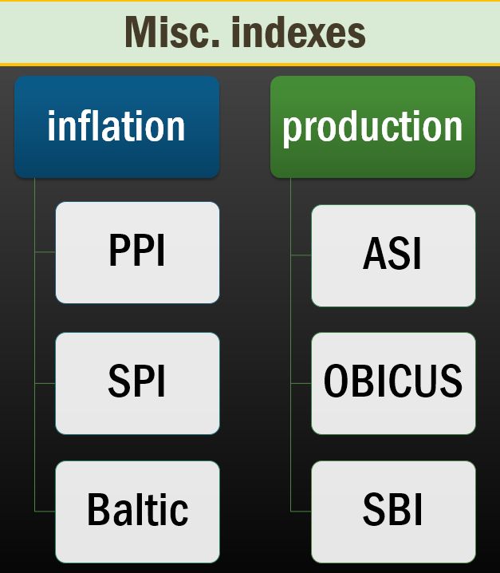
Ranking
FTP-2015
TPP, RCEP

